Slide 1


Slide 2
01
TECH STACK

Slide 3




Front End :
Android Studio - XML
Photoshop
Illustrator

Slide 4
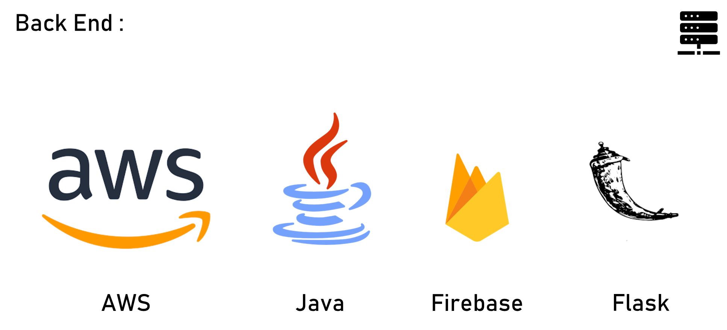

Slide 5

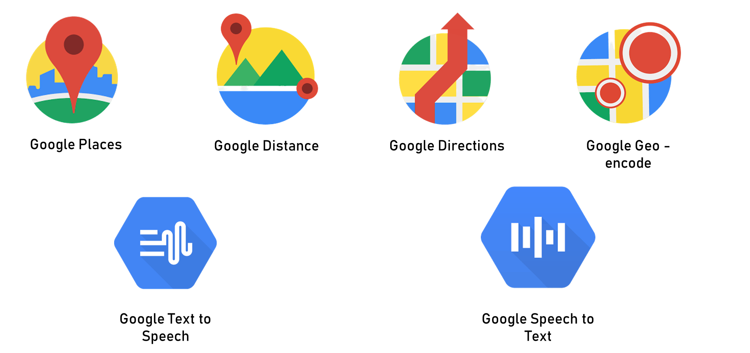
APIs :

Slide 6
02
FLOW CHART

Slide 7
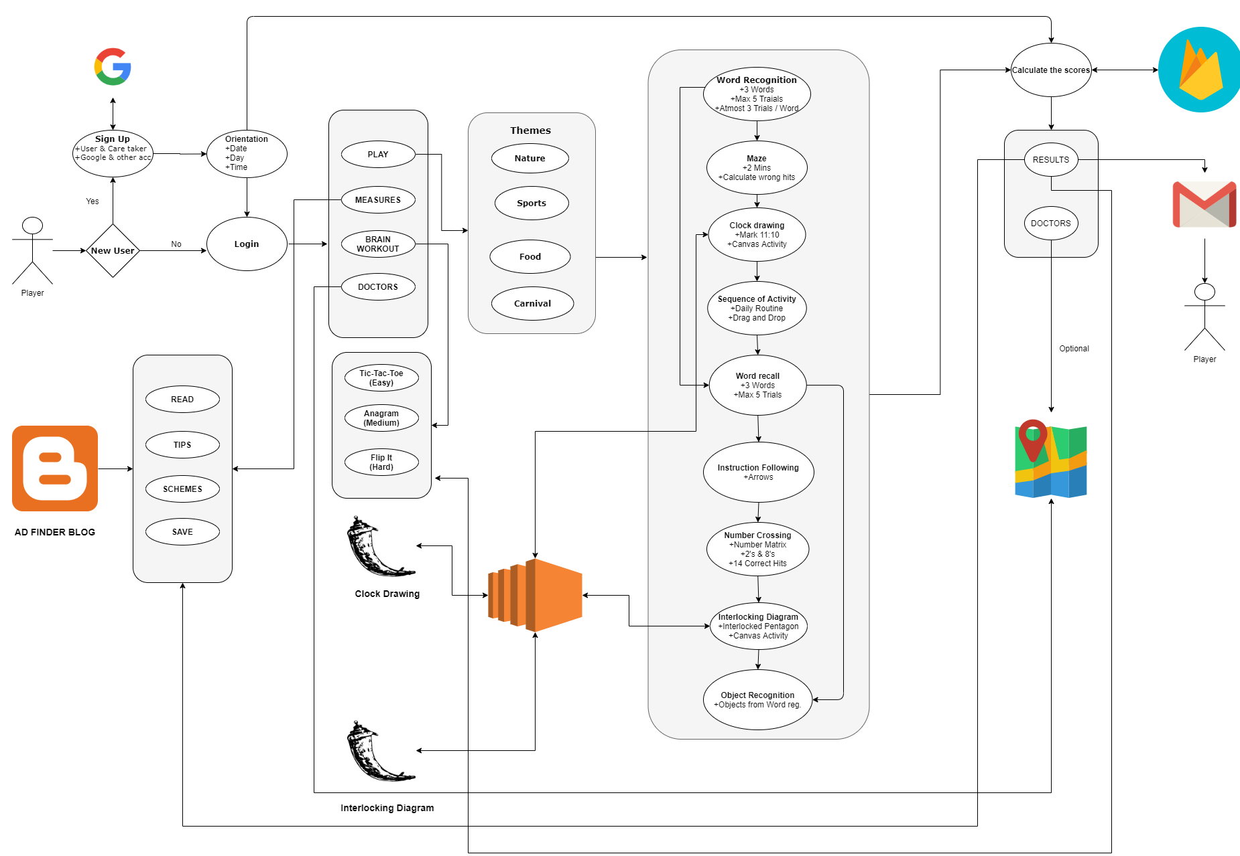

Slide 8
03
SCORING

Slide 9
LEVELS/TESTS | MMSE | ADAS | Mini – Cog | AD – Finder
Orientation | 5 | 8 | - | 5
Word Registration | 3 | - | - | 3
Maze | - | 5 | - | 7
Clock Drawing | - | - | 2 | 2
Instruction Following | 4 | 5 | - | 5
Sequence of Activity | - | 5 | - | 5
Word Recall (Mean with Object Recognition) | 3 | 10 | 3 | 3
Number Crossing ( |No. Of correct hits- No. of target hits missed- No. of Wrong hits| ) | - | 5 | - | 5
Interlocking Diagram | 1 | - | - | 2
Object Recognition | 2 | 5 | - | 3
TOTAL | (18/18)*30 | (43/43)*70 | 5 | 40

Slide 10
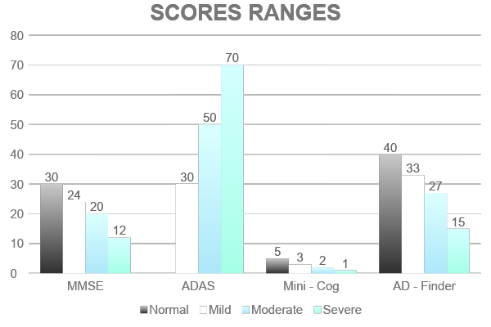
Each Value Represent Maximum Marks for that category

Slide 11
04
MODULE SCREENSHOTS

Slide 12

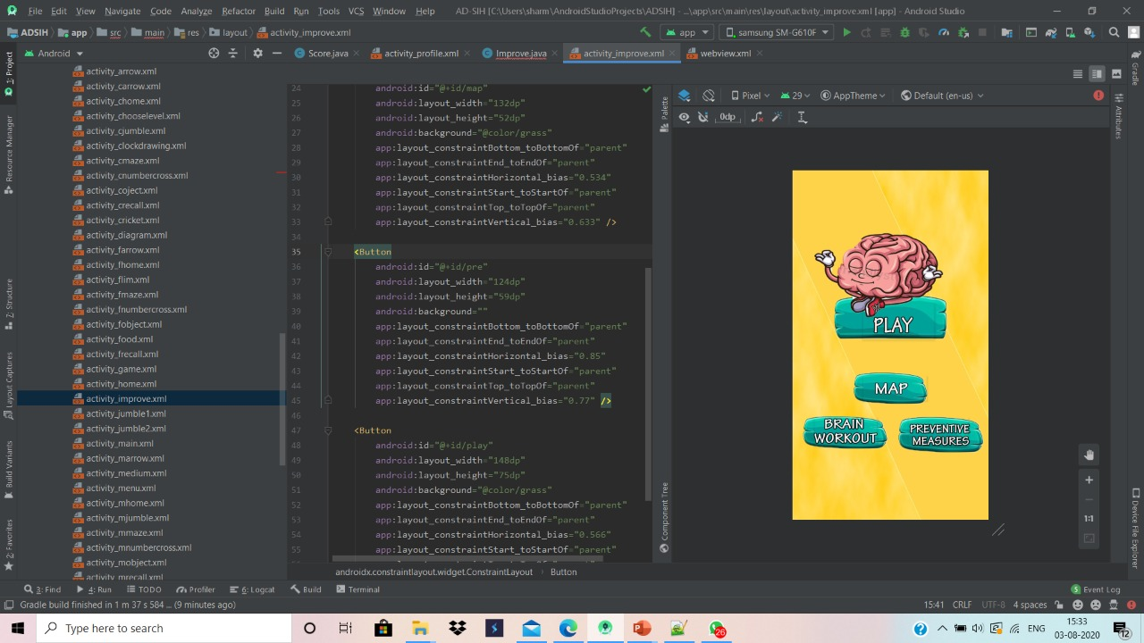
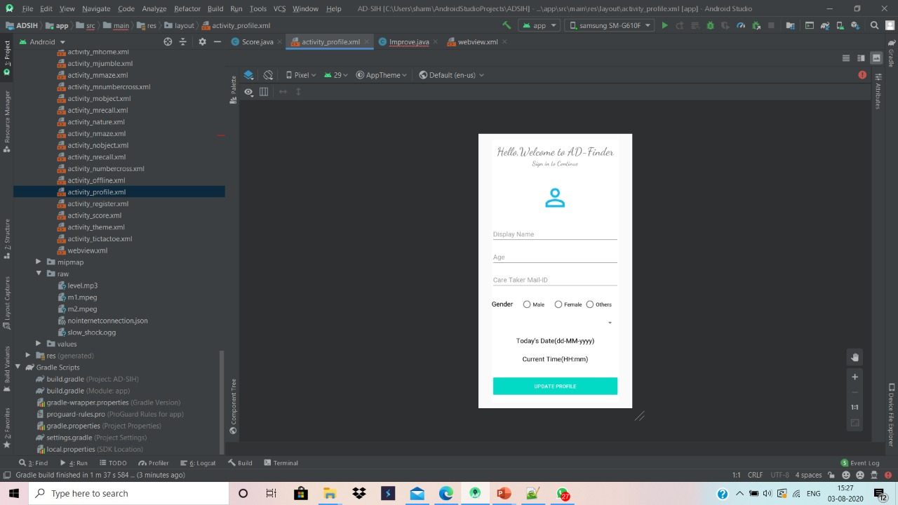
Registration & Orientation :

Slide 13
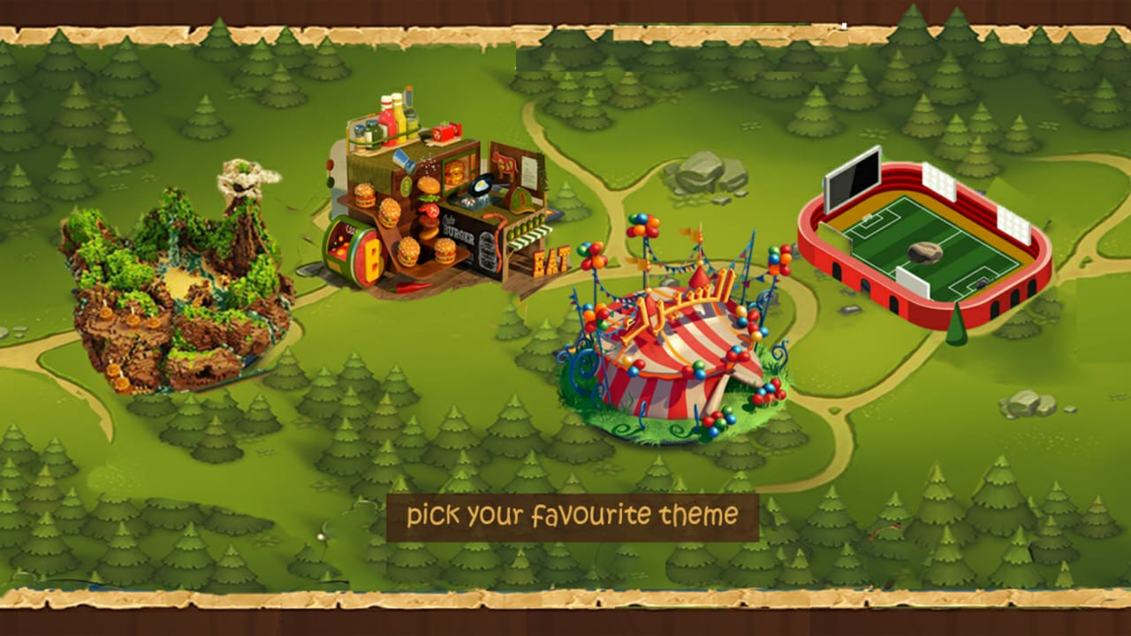
Themes Dashboard :

Slide 14
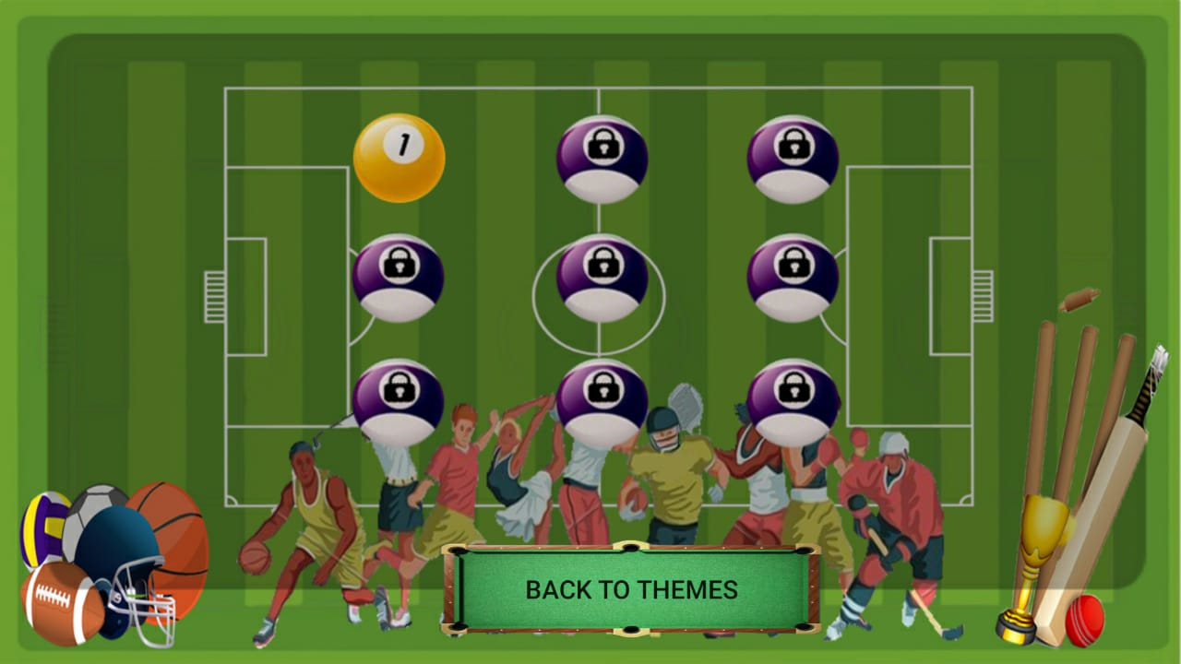
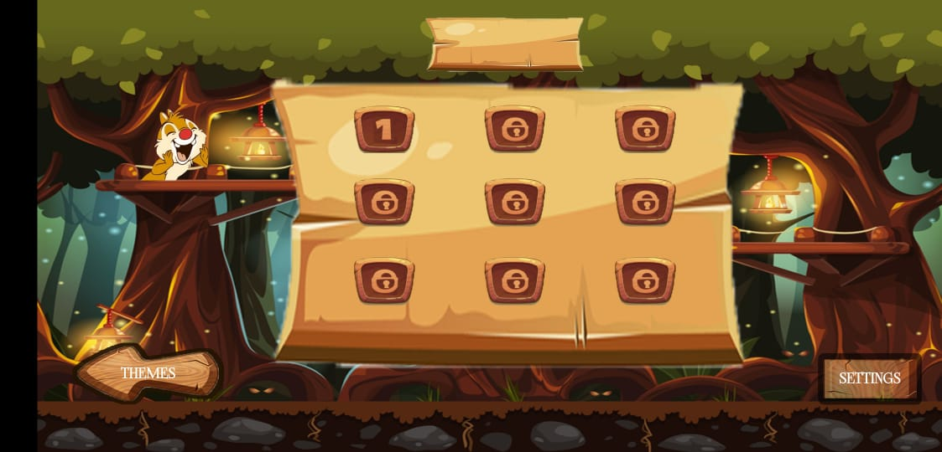
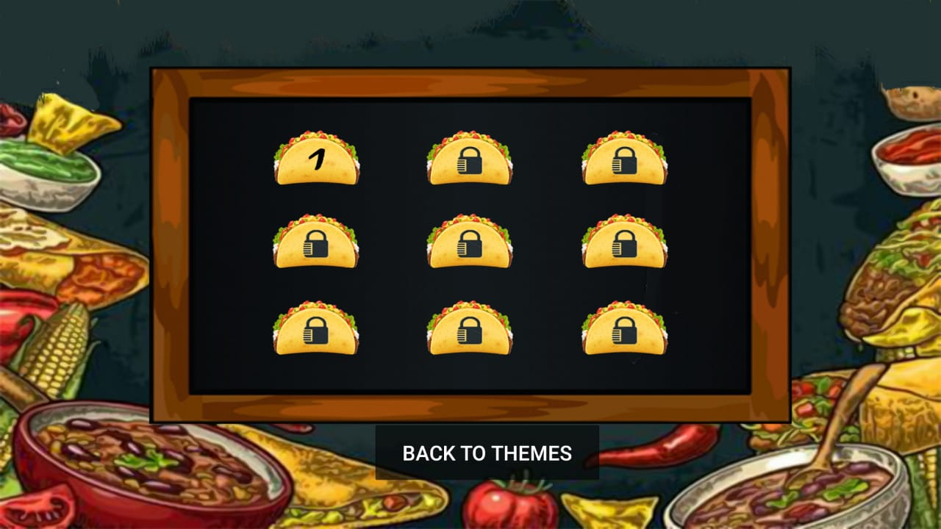

Levels Dashboard :

Slide 15
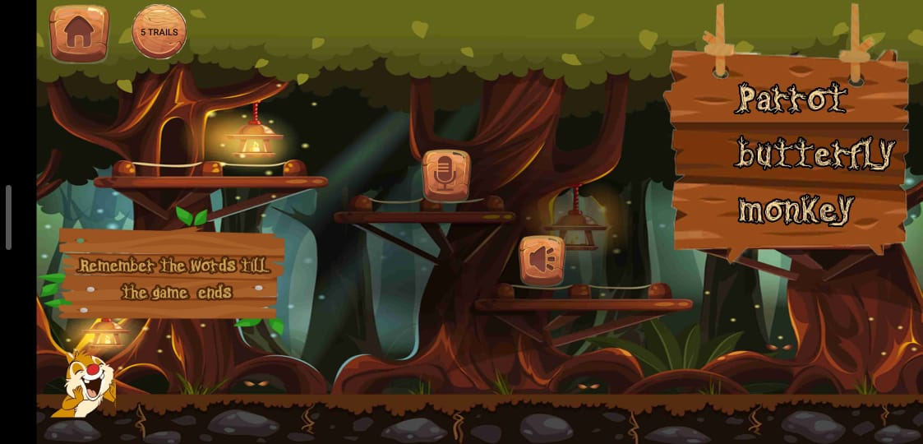
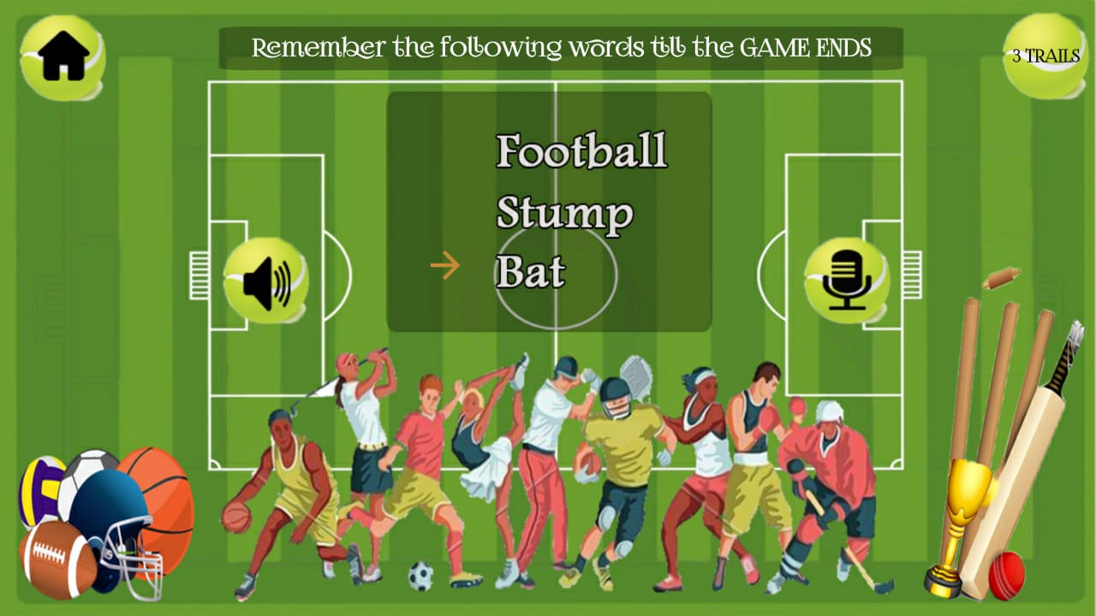
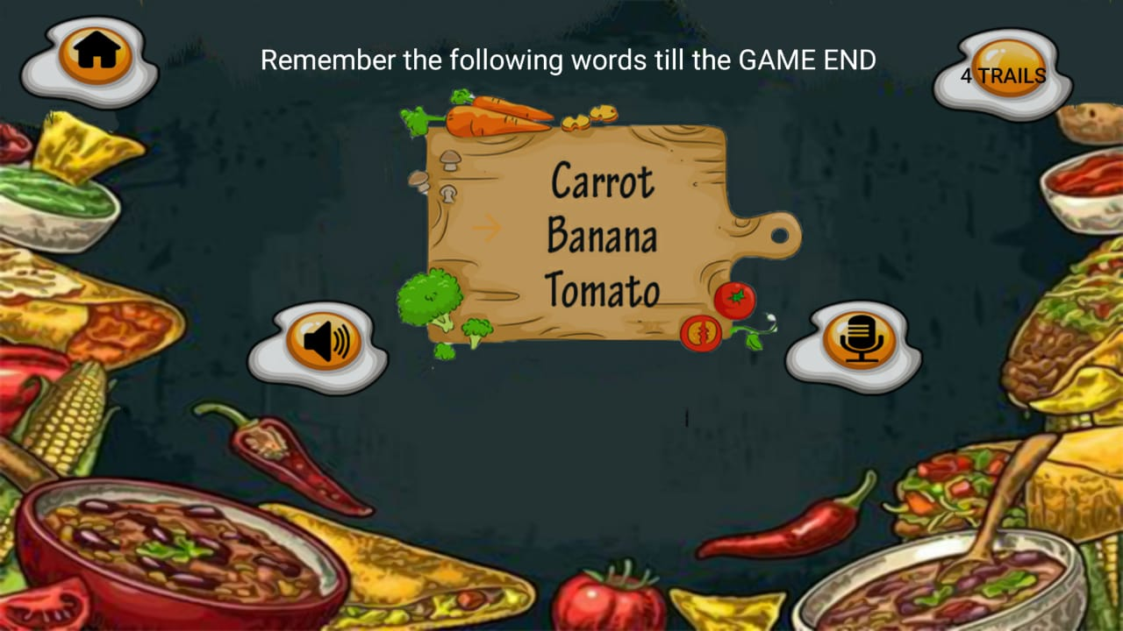
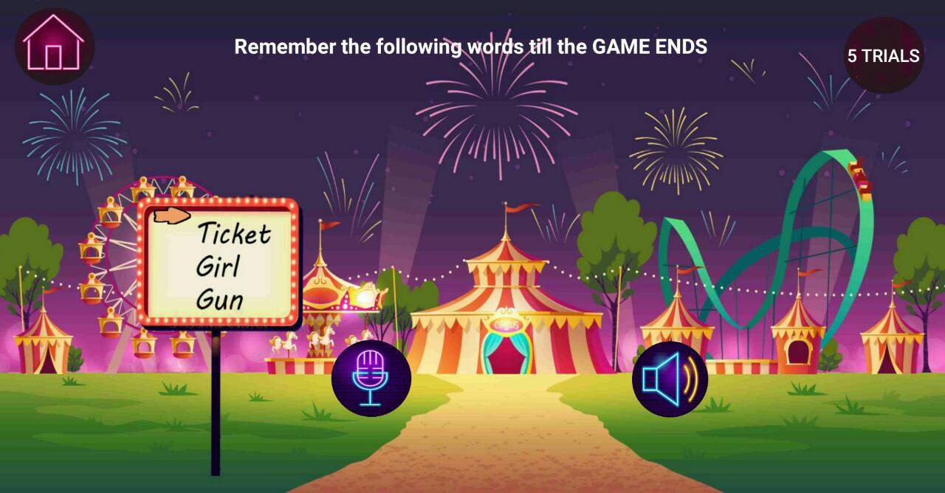
Word Registration :

Slide 16
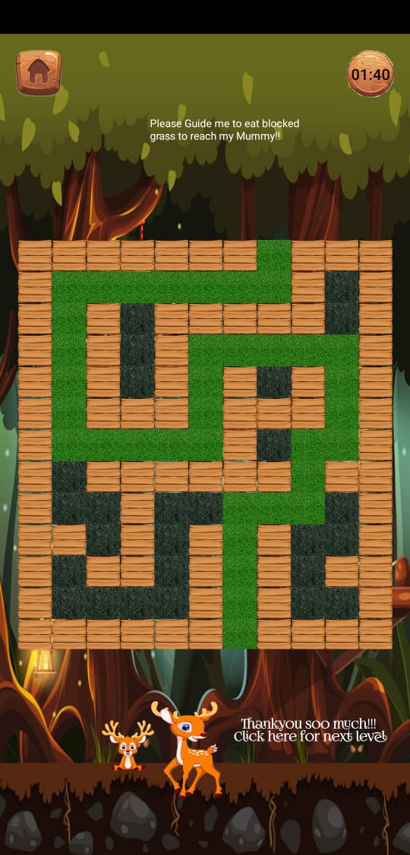
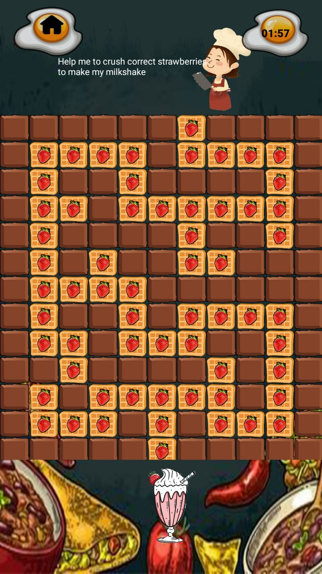
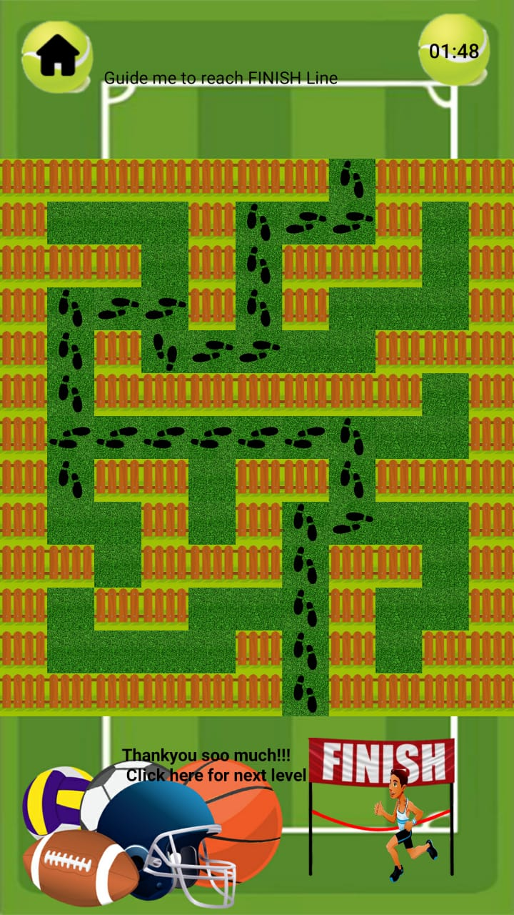
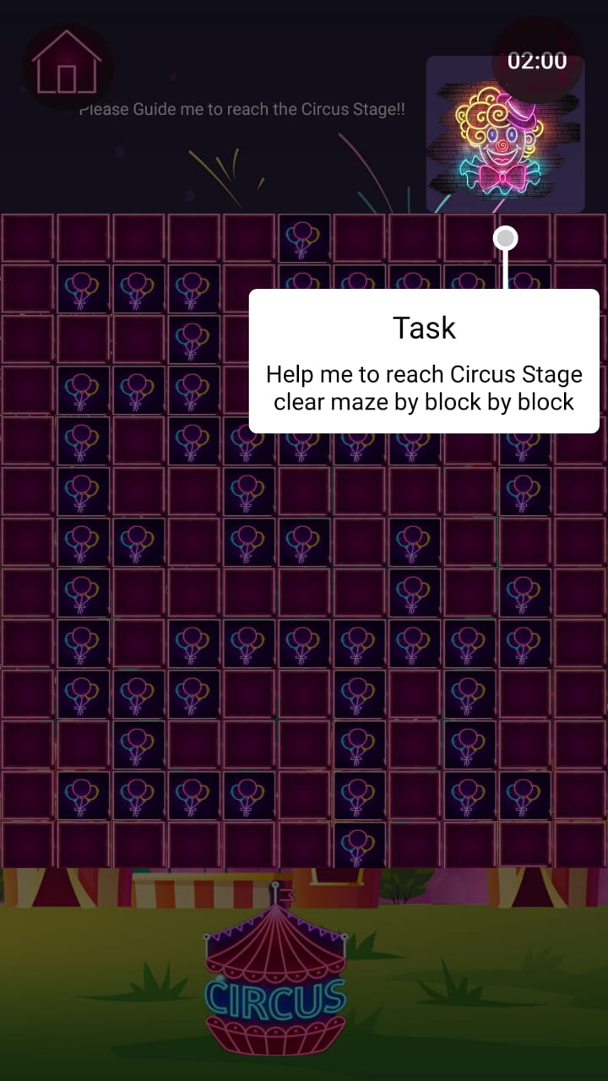
Maze :

Slide 17
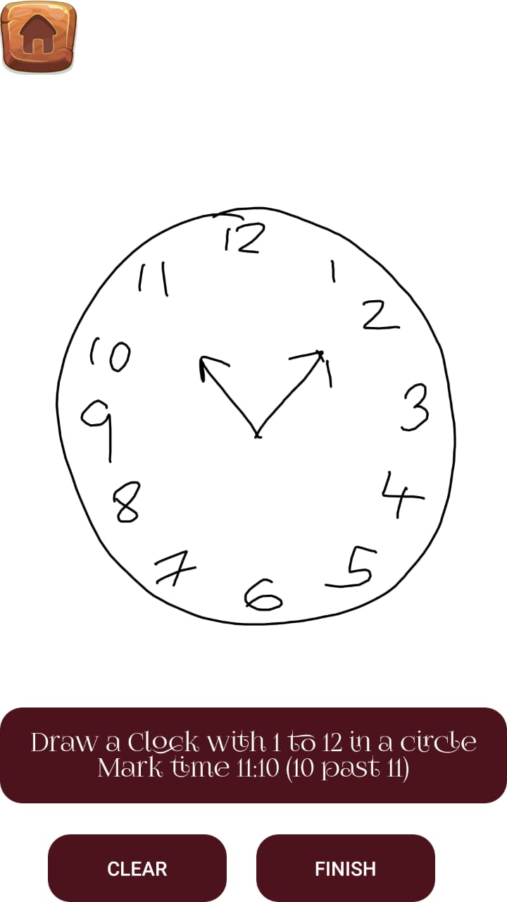
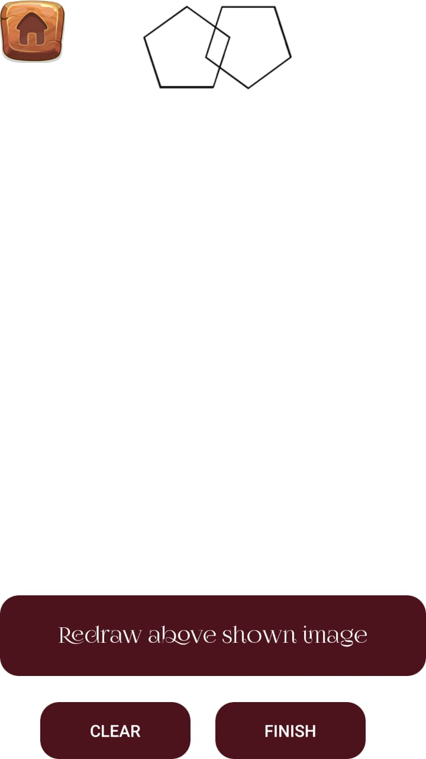
Clock Drawing & Interlocking Diagram :

Slide 18
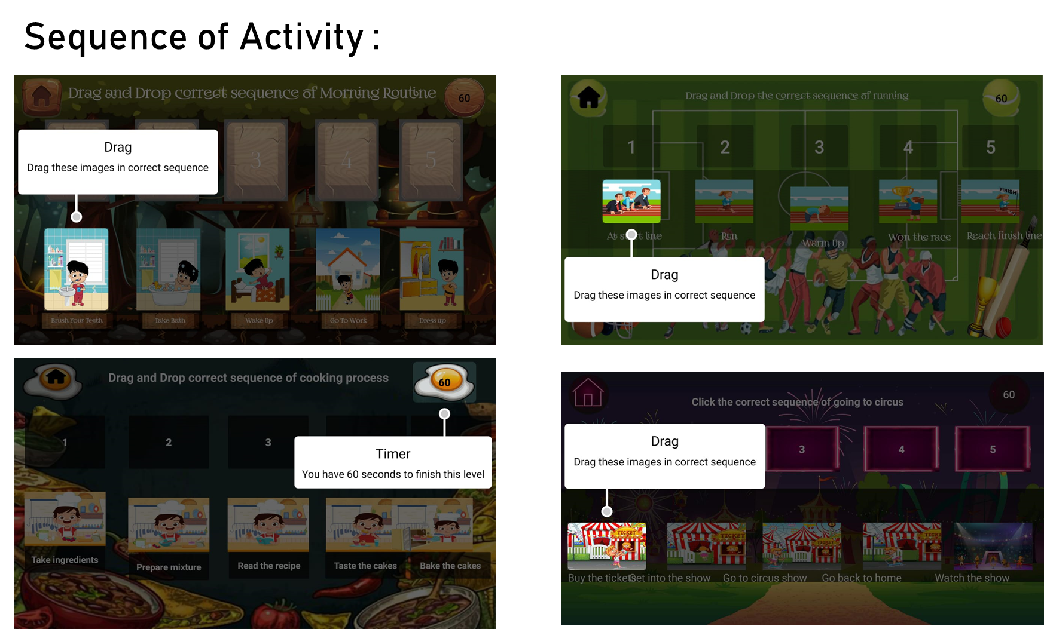

Slide 19
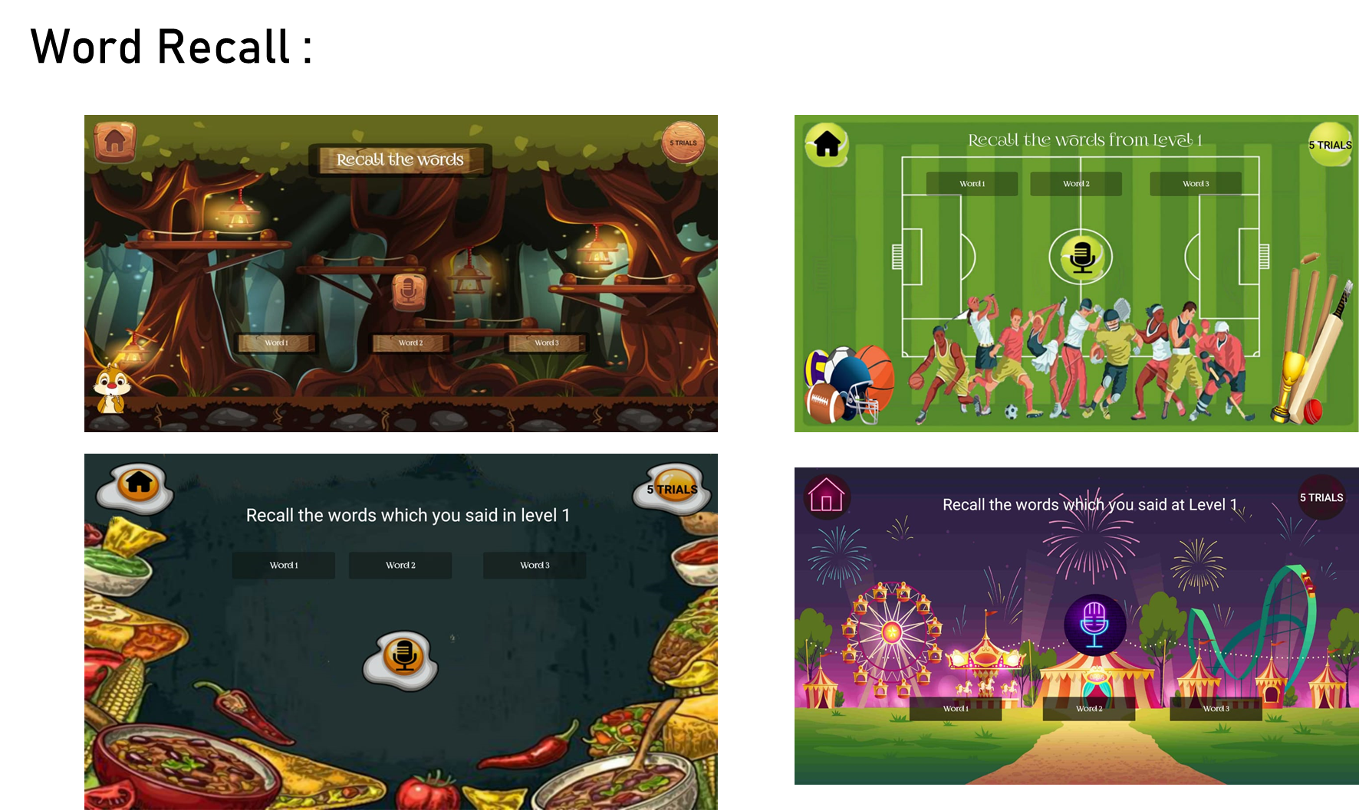

Slide 20
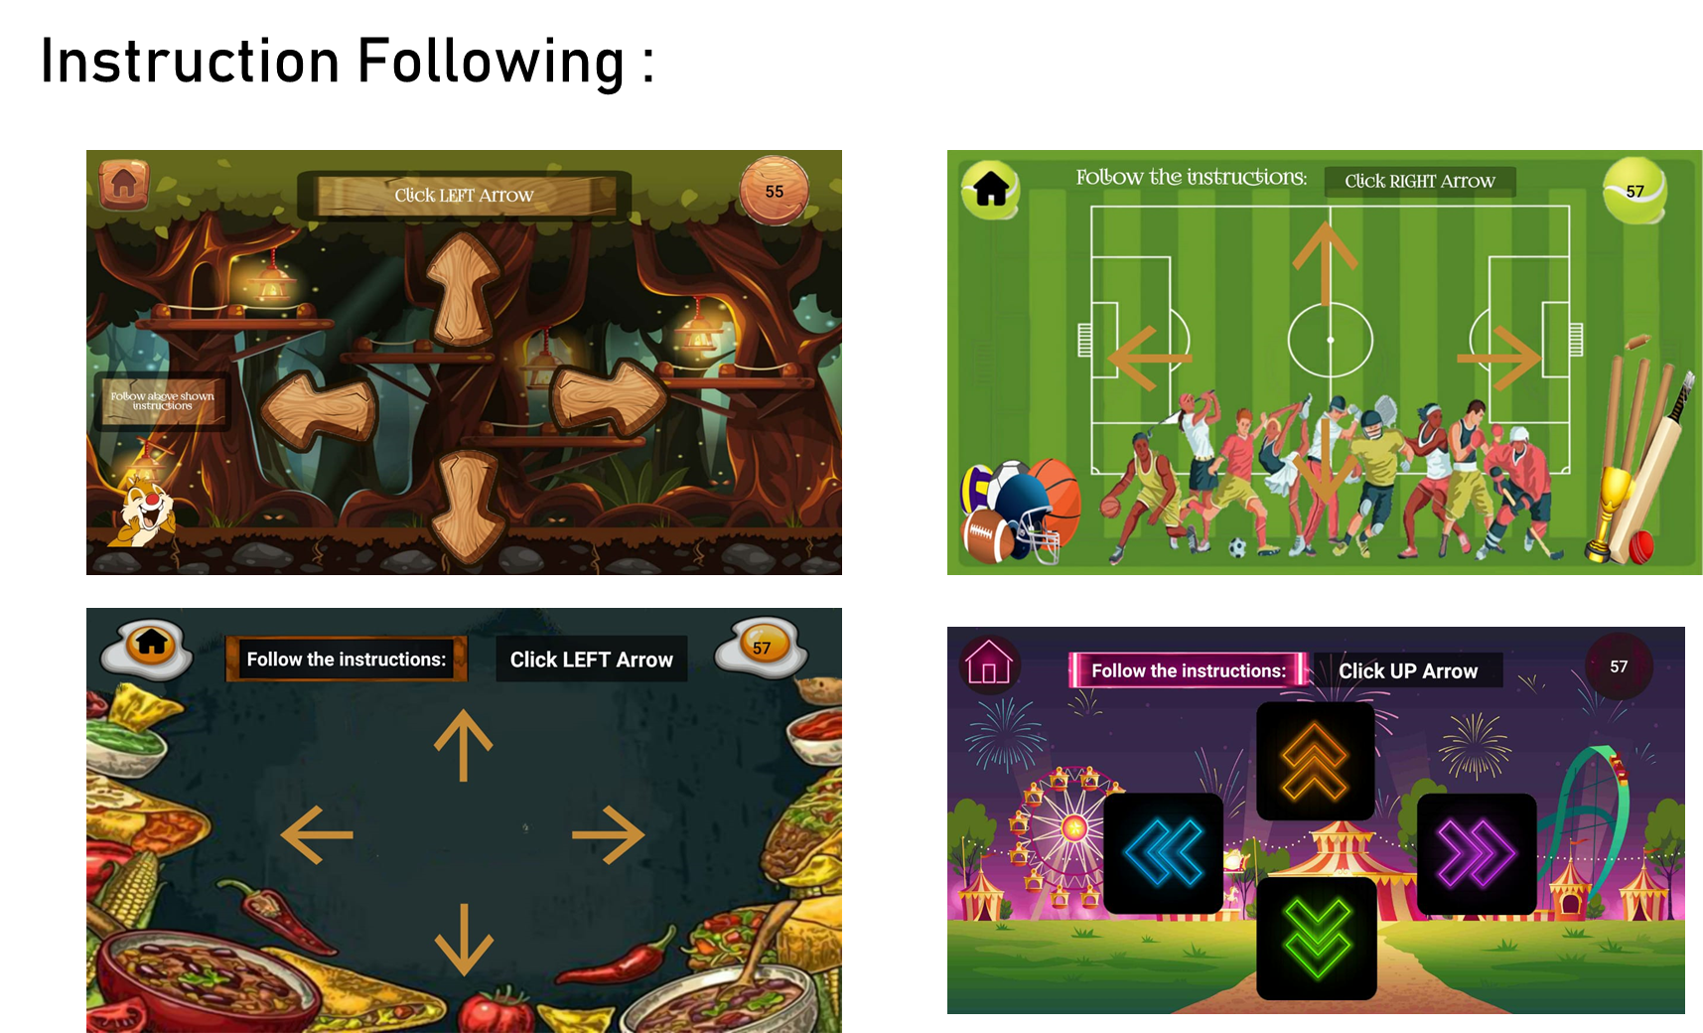

Slide 21
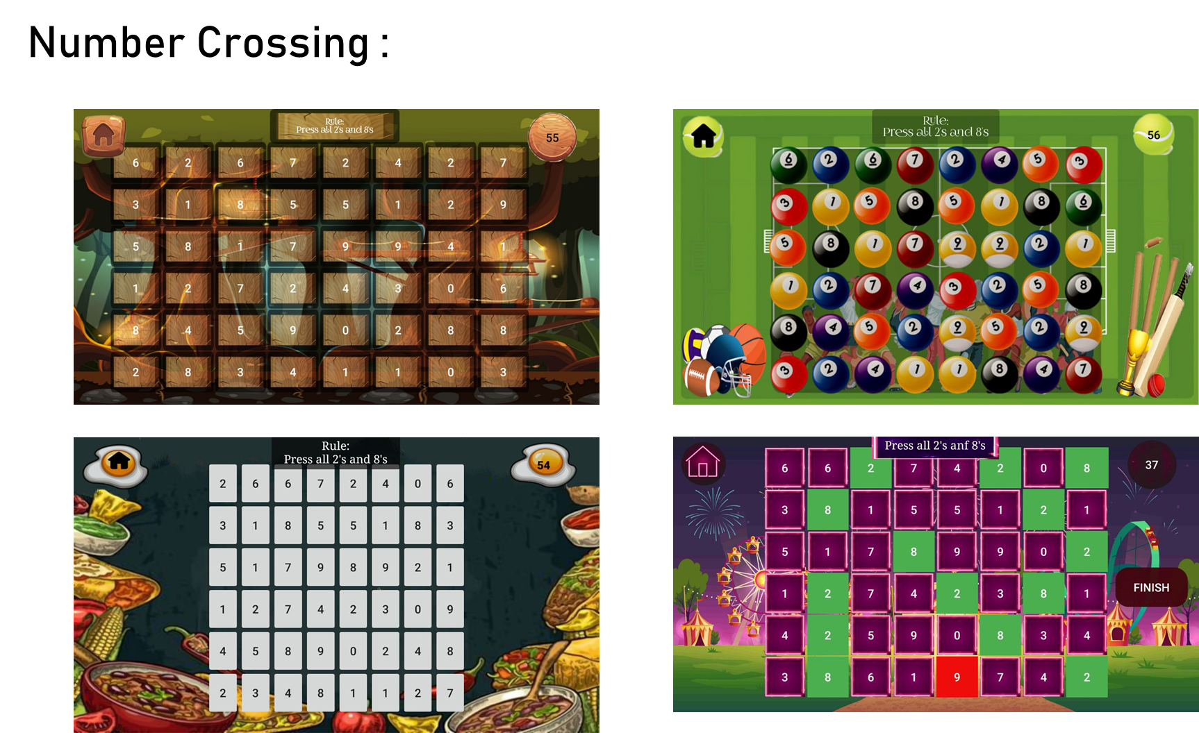

Slide 22
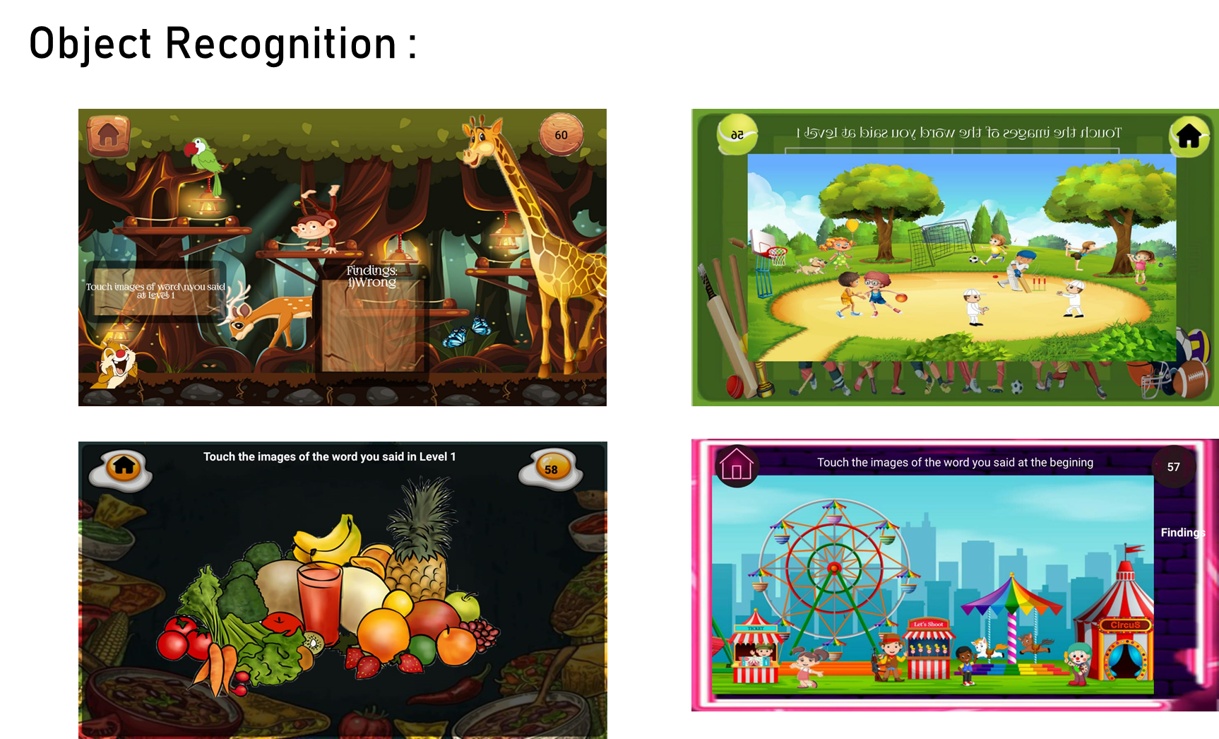

Slide 23
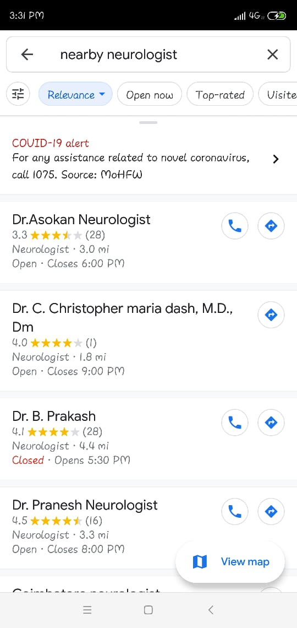
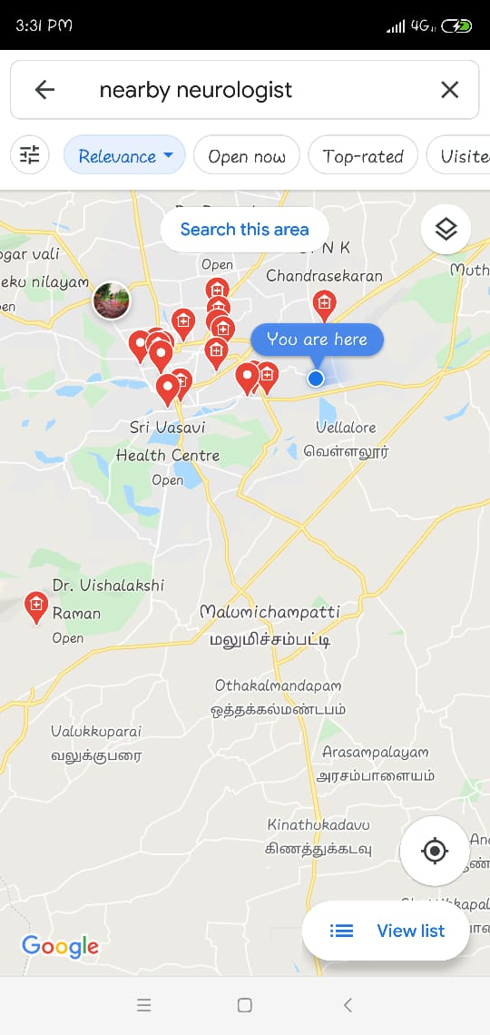
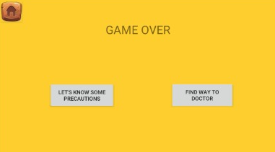
NEARBY DOCTORS – LOCATONS – DIRECTIONS :

Slide 24
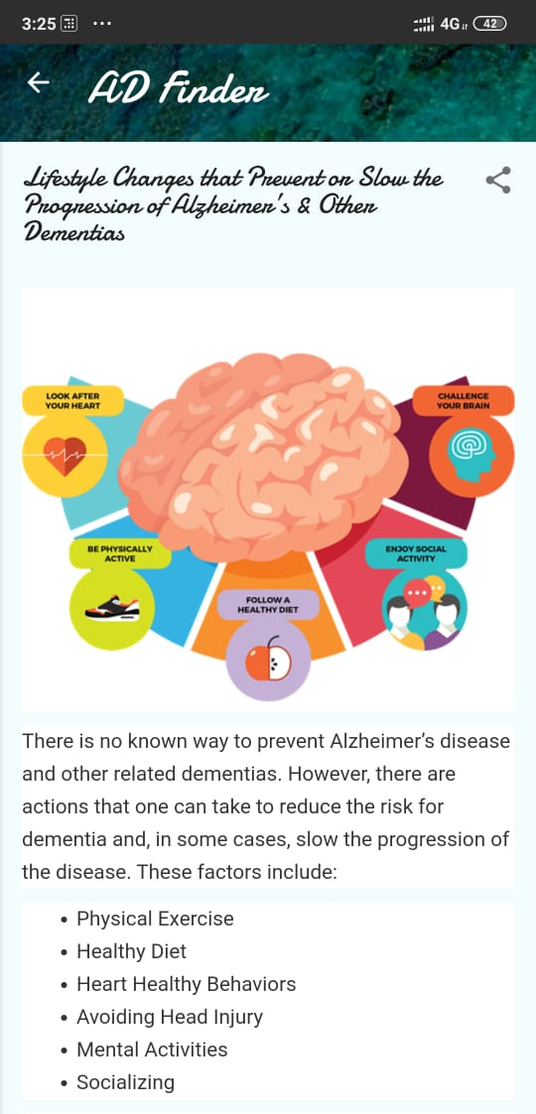
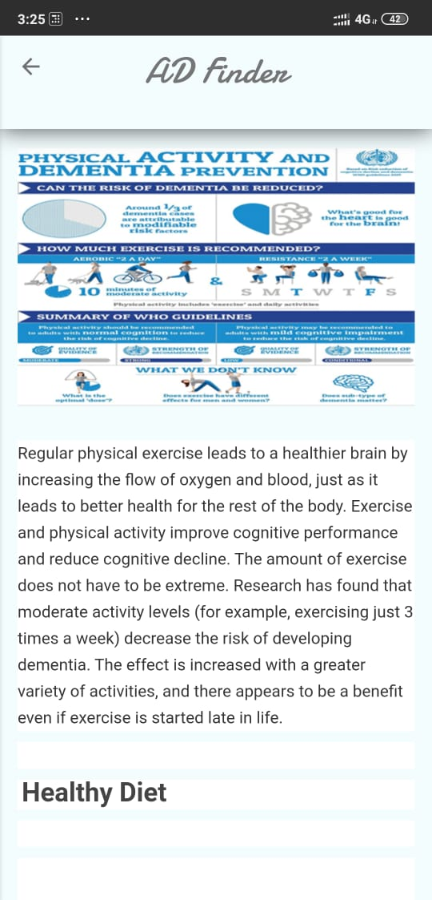
MEASURES :

Slide 25
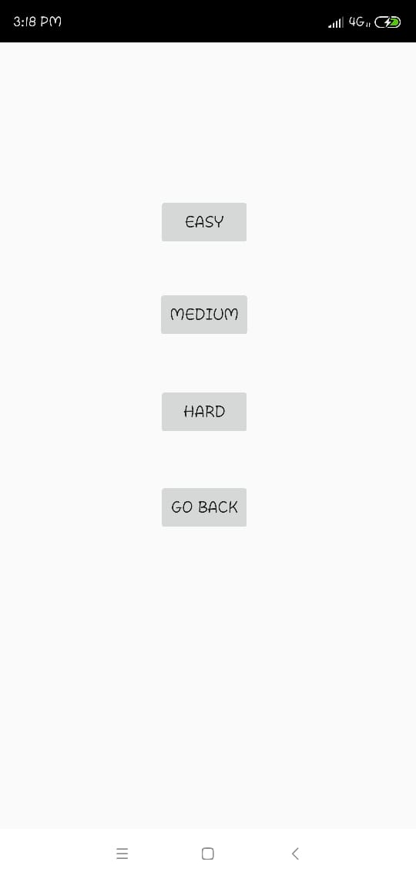
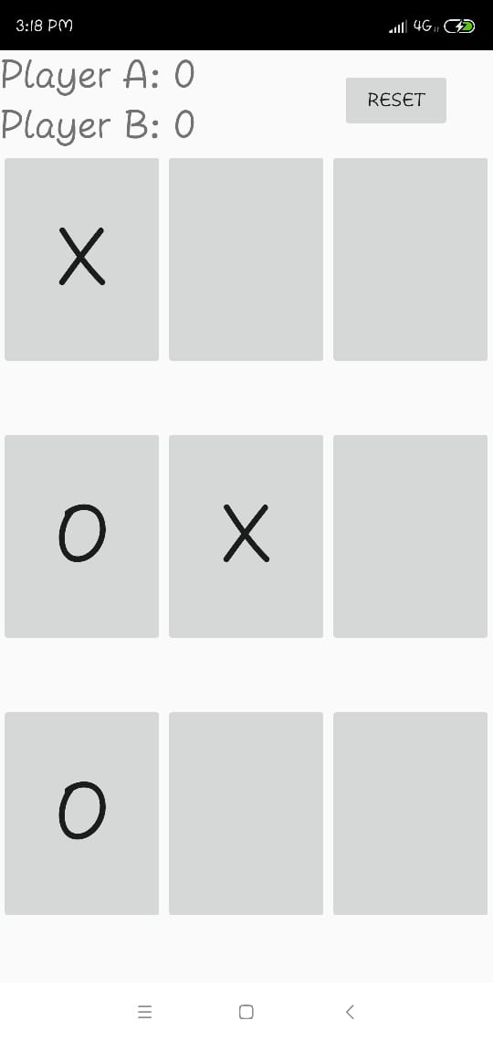
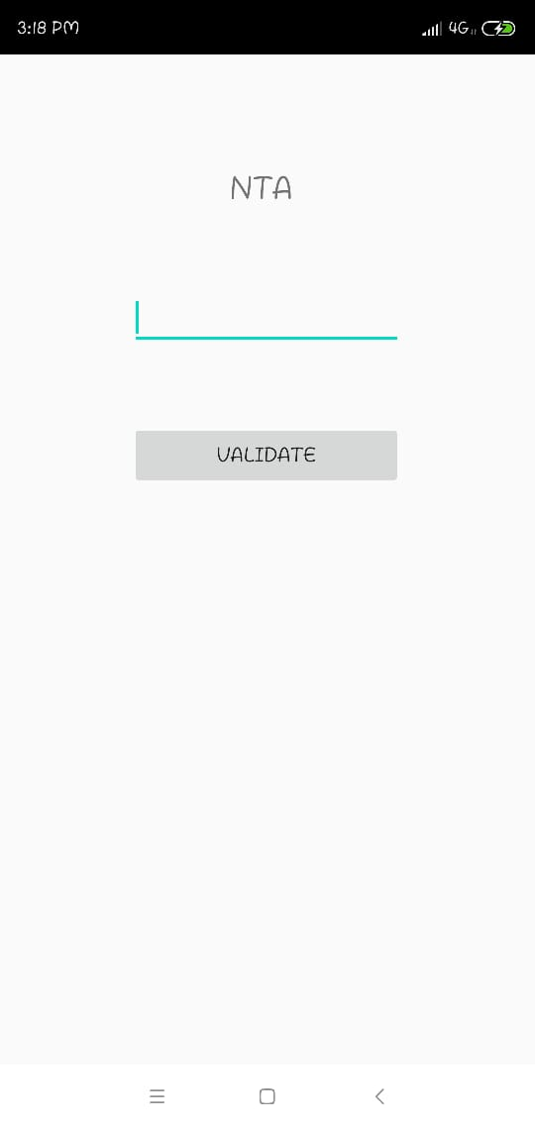
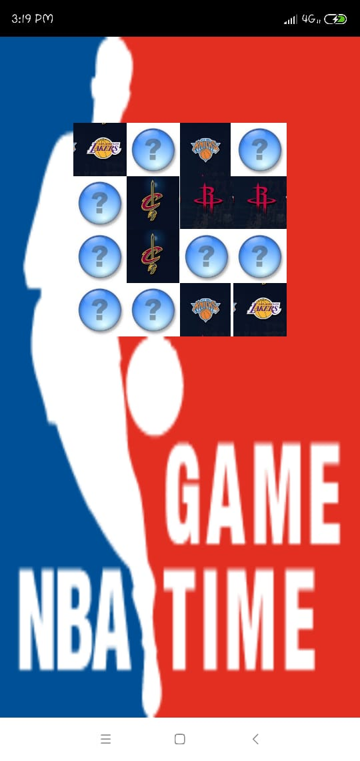
BRAIN WORKOUT :

Slide 26
SOCIETAL IMPACT
Green Economy
Reducing Alzheimer Growth
Giving better life for diagnosed users
Making diagnosis easy for doctors

Slide 27



OUTCOME
Scores
Nearby Doctors
Deatiled Report
Efficient Scores of ADAS,MMSE & Mini-Cog
Hospitals – Maps - Directions
Reports of test scores will be sent in mail.

Slide 28
NOVELTY
MUSIC
CANVAS DRAWING
BRAIN WORKOUT GAMES
CUSTMIZED BLOG
GAME

Slide 29


SHORT-COMINGS
Basic English Language
80% Accurate

Slide 30
FUTURISTIC IDEAS
ALERT
SLEEP TRACKER
BRAIN WORKOUT
VERNACULAR
GOVT. SCHEMES
SOCIALISING
Daily & Monthly progress reminders
Monitoring and Notifying weekly Sleep Progress
Randomizing game patterns and level improvements
Regional languages
Awareness and promotions
Community and Multiplayer game

Slide 31
“Innovation, as I understand it, is both about doing different things as well as doing things differently.”
—Kiran Mazumdar-Shaw, Biotech Entrepreneur

Slide 32
MADE IN INDIA , MADE FOR EVERYONE.
THANK YOU

